Slide 1



Análise do Dataset de Finanças no Power Bi
Fansoni Muzanzo
View in Power BI
Last data refresh:
16/03/2025 21:55:47 UTC
Downloaded at:
17/03/2025 10:00:19 UTC

Slide 2
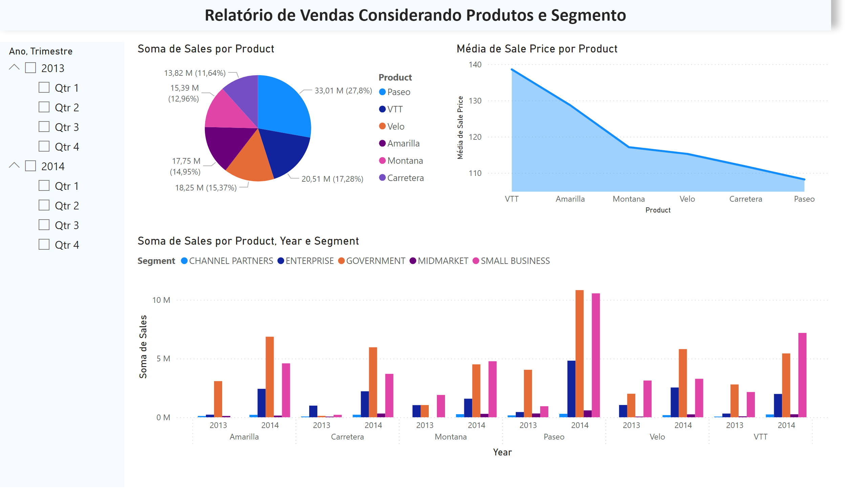
Página 1
Notes:
pieChart
No alt text provided
areaChart
No alt text provided
clusteredColumnChart
No alt text provided
slicer
No alt text provided
textbox
No alt text provided

Slide 3
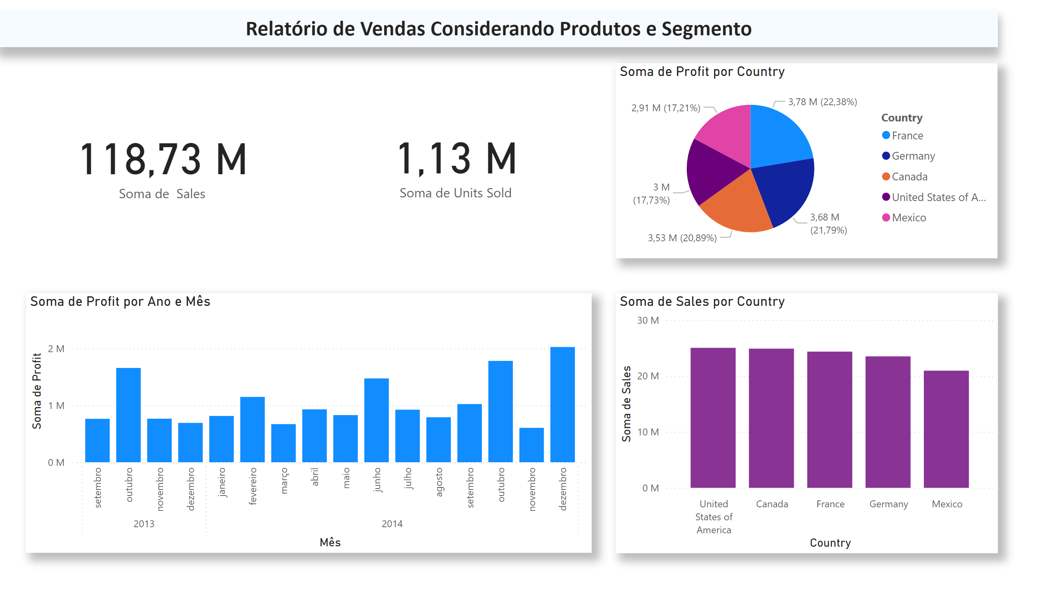
Página 2
Notes:
textbox
No alt text provided
card
No alt text provided
card
No alt text provided
pieChart
No alt text provided
clusteredColumnChart
No alt text provided
clusteredColumnChart
No alt text provided

Slide 4
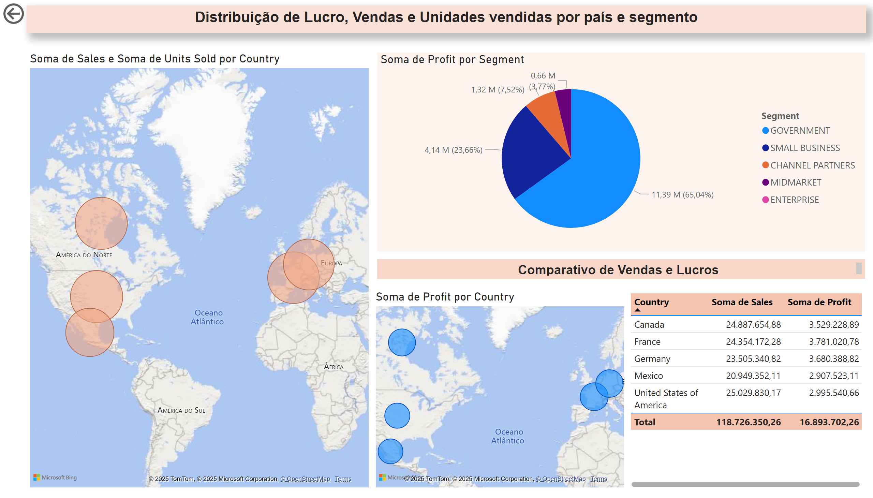
Página 3
Notes:
textbox
No alt text provided
pieChart
No alt text provided
map
No alt text provided
tableEx
No alt text provided
textbox
No alt text provided
map
No alt text provided
actionButton
No alt text provided

